Slide 1
Neural Network
Course Code: CSC4226
Course Title: Artificial Intelligence and Expert System
Dept. of Computer Science
Faculty of Science and Technology
Lecture No: | Eleven (11) | Week No: | Twelve (12) | Semester:
Lecturer: | Dr. Muhammad Firoz Mridha firoz.mridha@aiub.edu

Slide 2
Lecture Outline
Perceptron : As Model of Decision-Making.
Perceptron for Classification
Limitations of Perceptron
Sigmoid Neuron
Simple Mathematical Model for a Neuron
Neural Network Structures
Backpropagation Algorithm
Calculating Total Error

Slide 3
A Simple Decision
Say you want to decide whether you are going to attend a cheese festival this upcoming weekend. There are three variables that go into your decision:
1. Is the weather good?
2. Does your friend want to go with you?
3. Is it near public transportation?
We’ll assume that answers to these questions are the only factors that go into your decision.

Slide 4
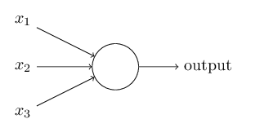
A perceptron
We can graphically represent this decision algorithm as an object that takes 3 binary inputs and produces a single binary output:
This object is called a perceptron when using the type of weighting scheme we just developed.

Slide 5
A Simple Decision, cont.
I will write the answers to these question as binary variables x_{i} ,
with zero being the answer ‘no’ and one being the answer ‘yes’:
1. Is the weather good? x₁
2. Does your friend want to go with you? x₂
3. Is it near public transportation? x₃
Now, what is an easy way to describe the decision statement resulting from these inputs.

Slide 6
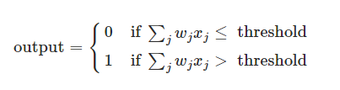
Perceptron: Artificial Neurons
Perceptron's were developed in the 1950s and 1960s by the scientist Frank Rosenblatt, inspired by earlier work by Warren McCulloch and Walter Pitts. Today, it's more common to use other models of artificial neurons.
Rosenblatt proposed a simple rule to compute the output. He introduced weights, w₁,w₂,.., real numbers expressing the importance of the respective inputs to the output.
The neuron's output, 0 or 1, is determined by whether the weighted sum ∑_{j}w_{j}x_{j} is less than or greater than some threshold value.
Just like the weights, the threshold is a real number which is a parameter of the neuron.

Slide 7
A Simple Decision, cont.
We could determine weights w_{i} indicating how important each feature is to whether you would like to attend. We can then see if:
x1 · w1 + x2 · w2 + x3 · w3 ≥ threshold
For some pre-determined threshold. If this statement is true, we would attend the festival, and otherwise we would not.

Slide 8
A Simple Decision, cont.
For example, if we really hated bad weather but care less about going with our friend and public transit, we could pick the weights 6, 2 and 2.
With a threshold of 5, this causes us to go if and only if the weather is good.
What happens if the threshold is decreased to 3?
What about if it is decreased to 1?

Slide 9


A Simple Decision, cont.
If we define a new binary variable y that represents whether we go to the festival, we can write this variable as:
Now, if I rewrite this in terms of a dot product between the vector of all binary inputs (x), a vector of weights (w), and change the threshold to the negative bias (b), we have:
So we found separating hyperplanes.

Slide 10

How do our brains work?
The Brain is a massively parallel information processing system.
Our brains are a huge network of processing elements. A typical brain contains a network of 10 billion neurons.

Slide 11
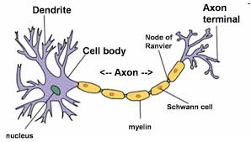
Neuron: Biological Model
Dendrites: Input
Cell body: Processor
Synaptic: Link
Axon: Output

Slide 12
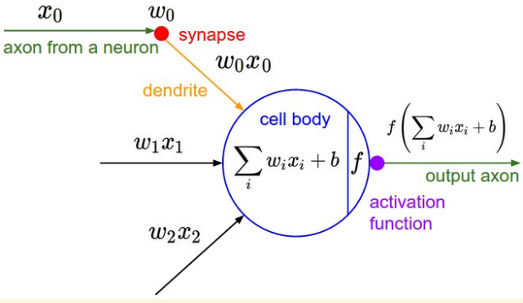
Neuron: Mapped to Computational Model

Slide 13
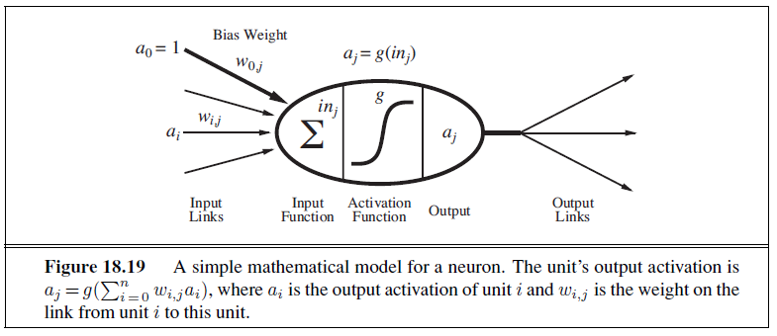
Neuron: Mathematical Model

Slide 14
How do ANNs work?
Input
xm
. . . . . . . . . . . .
x2
x1
Processing
∑
∑= X₁+X₂ + ….+X_{m} =y
Output
y

Slide 15

How do ANNs work?
Not all inputs are equal
xm
. . . . . . . . . . . .
x2
x1
Input
w_{m}
w₂
w₁
weights
. . . . .
Processing
∑
∑= X₁w₁+X₂w₂ + ….+X_{m}w_{m} =y
Output
y

Slide 16

How do ANNs work?
xm
. . . . . . . . . . . .
x2
x1
Input
The signal is not passed down to the
next neuron as it is
w_{m}
w₂
w₁
weights
. . . . .
Processing
∑
Transfer Function (Activation Function)
f(v_{k})
Output
y

Slide 17
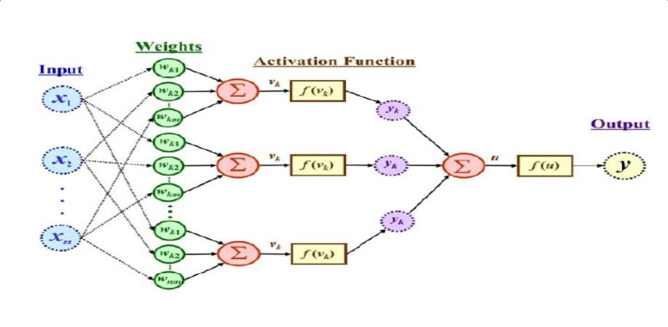
How do ANNs work?
The output is a function of the input, that is affected by the weights, and the transfer functions

Slide 18
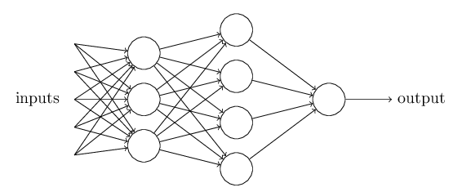
A Network of Perceptrons
In this network, the first column of perceptrons - what we'll call the first layer of perceptrons - is making three very simple decisions, by weighing the input evidence.
Each of those perceptrons is making a decision by weighing up the results from the first layer of decision-making.
In this way a perceptron in the second layer can make a decision at a more complex and more abstract level than perceptrons in the first layer.
And even more complex decisions can be made by the perceptron in the third layer.
In this way, a many-layer network of perceptrons can engage in sophisticated decision making.

Slide 19
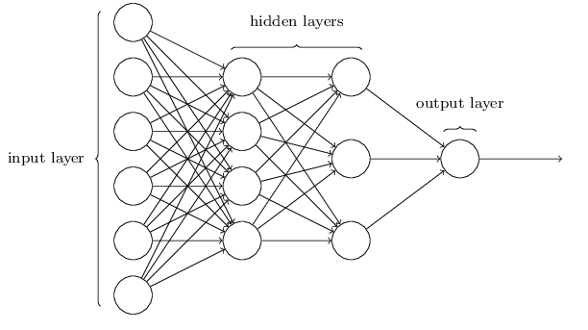
The architecture of neural networks
The input and outputs are typically represented as their own neurons, with the other neurons named hidden layers

Slide 20
Perceptron: Limitations
The Perceptron can only model linearly separable functions,
It cannot model XOR function as it is nonlinearly separable.
When the two classes are not linearly separable, it may be desirable to obtain a linear separator that minimizes the mean squared error.

Slide 21
Sigmoid Neurons
Suppose we have a network of perceptrons that we'd like to use to learn to solve some problem.
For example, the inputs to the network might be the raw pixel data from a scanned, handwritten image of a digit.
And we'd like the network to learn weights and biases so that the output from the network correctly classifies the digit.
To see how learning might work, suppose we make a small change in some weight (or bias) in the network.
What we'd like is for this small change in weight to cause only a small corresponding change in the output from the network

Slide 22
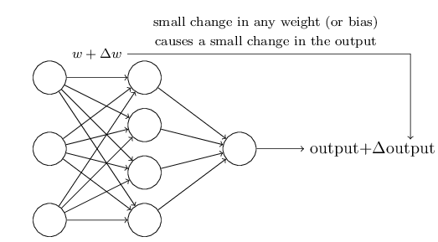
Sigmoid Neurons, Cond
If it were true that a small change in a weight (or bias) causes only a small change in output, then we could use this fact to modify the weights and biases to get our network to behave more in the manner we want.
The problem is that this isn't what happens when our network contains perceptrons.
A small change in the weights or bias of any single perceptron in the network can sometimes cause the output of that perceptron to completely flip, say from 0 to 1.
That flip may then cause the behavior of the rest of the network to completely change in some very complicated way.

Slide 23
Sigmoid Neurons, Cond
We can overcome this problem by introducing a new type of artificial neuron called a sigmoid neuron.
Sigmoid neurons are like perceptron but modified so that small changes in their weights and bias cause only a small change in their output.
That's the crucial fact which will allow a network of sigmoid neurons to learn.
Just like a perceptron, the sigmoid neuron has inputs, x₁,x₂,…. But instead of being just 0 or 1, these inputs can also take on any values between 0 and 1.
Also just like a perceptron, the sigmoid neuron has weights for each input, w₁,w₂,…, and an overall bias, b.
Instead, it's σ(w⋅x+b), where
σ is called the sigmoid function.
But the output is not 0 or 1.

Slide 24


Sigmoid Function
Sigmoid Function is defined by
The output of a sigmoid neuron with inputs x₁,x₂,…, weights w₁,w₂,…, and bias b is
σ(x · w + b)
This perfectly mimics logistic regression, and in fact uses the logit function to do so.
In the neural network literature, the logit function is called the sigmoid function, thus leading to the name sigmoid neuron for a neuron that uses its logic.

Slide 25
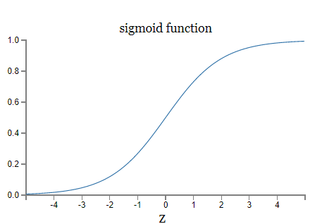
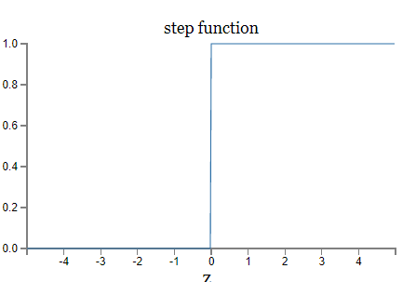
Sigmoid Function
Sigmoid Function is a smoothed-out version of a step function

Slide 26

Activation Functions
Activation Function derive the output form weighted sum
In the sigmoid neuron example, the choice of what function to use to go from x · w + b to an output is called the activation function.
Using a logistic, or sigmoid, activation function has some benefits in being able to easily take derivatives and the interpret them using logistic regression.
Other choices have certain benefits that have recently grown in popularity. Some of these include:
hyperbolic tan: tanh(z) = 2σ(2x) − 1
rectified linear unit: ReLU(z) = max(0, z)
leaky rectified linear unit
maxout

Slide 27
How to learn the weights
Learning using Training data
There are various learning algorithm
Here we all talk about Back Propagation Algorithm

Slide 28
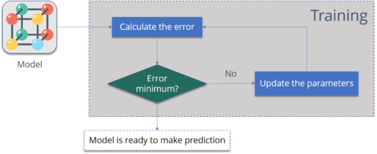
How to learn the weights

Slide 29
The Backpropagation Algorithm
Back-propagation is an example of supervised learning is used at each layer to minimize the error between the layer’s response and the actual data
The error at each hidden layer is an average of the evaluated error
Hidden layer networks are trained this way

Slide 30
The Backpropagation Algorithm
The goal of backpropagation is to optimize the weights so that the neural network can learn how to correctly map arbitrary inputs to outputs.
The most basic method of training a neural network is trial and error.
If the network isn't behaving the way it should, change the weighting of a random link by a random amount. If the accuracy of the network declines, undo the change and make a different one.
It takes time, but the trial and error method does produce results.

Slide 31
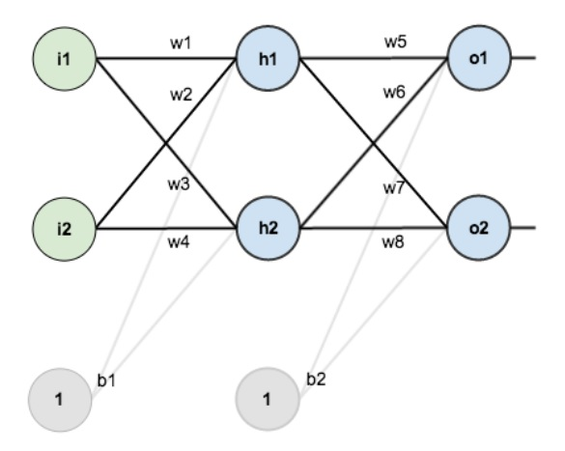
Learning using Back Propagation
Sample Neural Network to Calculate Total Error Using Forward Pass Back propagation
The network contains the following:
two inputs
two hidden neurons
two output neurons
two biases
Source: https://www.edureka.co/blog/backpropagation/

Slide 32
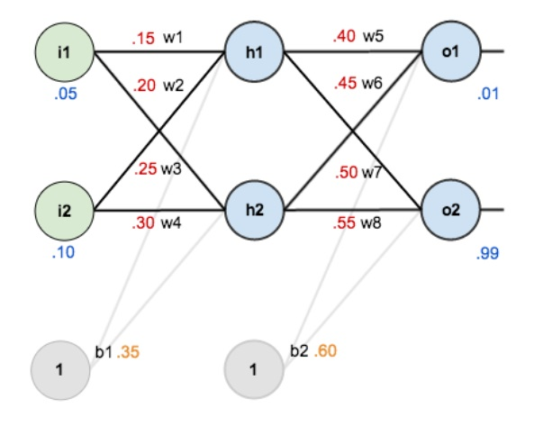
Learning using Back Propagation
Weight initialization and
Error calculation for a sample data: 0.05, 0.10 → 0.01, 0.99

Slide 33

Learning using Back Propagation
Calculation at node h1

Slide 34


Learning using Back Propagation
Output from node h1 using sigmoid function

Slide 35
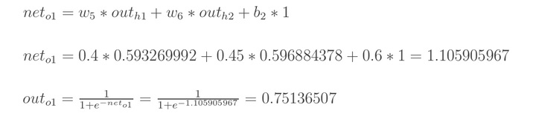

Learning using Back Propagation
Calculation at node o1 and o2

Slide 36


Learning using Back Propagation
Calculation Total Error
The total error for the neural network is the sum of these errors:

Slide 37
Learning using Back Propagation
Now propagate the error backward to adjust the weights in the network
Repeat the process for all data in training set.

Slide 38
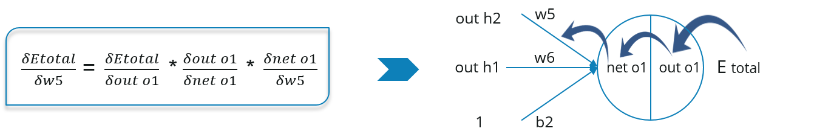
Learning using Back Propagation
Now, we will propagate backwards. This way we will try to reduce the error by changing the values of weights and biases.
Consider W5, we will calculate the rate of change of error w.r.t change in weight W5.

Slide 39
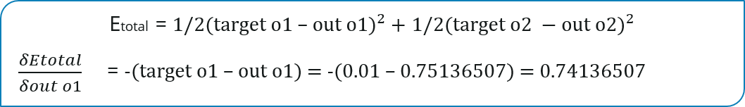
Learning using Back Propagation
Since we are propagating backwards, first thing we need to do is, calculate the change in total errors w.r.t the output O1 and O2.

Slide 40
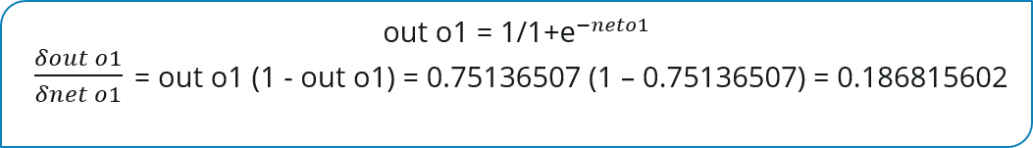
Learning using Back Propagation
Now, we will propagate further backwards and calculate the change in output O1 w.r.t to its total net input.

Slide 41
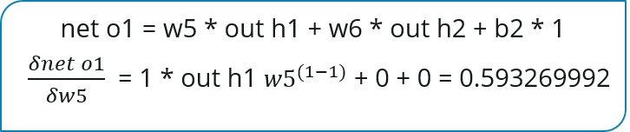
Learning using Back Propagation
Let’s see now how much does the total net input of O1 changes w.r.t W5?

Slide 42
Learning using Back Propagation
Putting all the values together and calculating the updated weight value

Slide 43
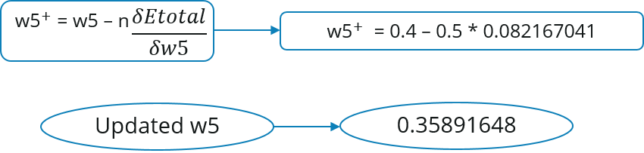
Learning using Back Propagation
Let’s calculate the updated value of W5:

Slide 44
Learning using Back Propagation
Similarly, we can calculate the other weight values as well.
After that we will again propagate forward and calculate the output. Again, we will calculate the error.
If the error is minimum we will stop right there, else we will again propagate backwards and update the weight values.
This process will keep on repeating until error becomes minimum.

Slide 45
Size of Training Set
No one‐fits‐all formula
Over fitting can occur if a “good” training set is not chosen
What constitutes a “good” training set?
Samples must represent the general population.
Samples must contain members of each class.
Samples in each class must contain a wide range of variations or noise effect.
The size of the training set is related to the number of hidden neurons

Slide 46
References
Chapter 18: Learning From Examples , Pages 727-34“Artificial Intelligence: A Modern Approach,” by Stuart J. Russell and Peter Norvig
“Neural Computing Theory and Practice,” by Philip D. Wasserman .
“Neural Network Design,” by Martin T. Hagan, Howard B. Demuth, Mark H. Beale
http://euler.stat.yale.edu/~tba3/stat665/lectures/lec12/lecture12.pdf
http://neuralnetworksanddeeplearning.com/chap1.html

Slide 47
Books
“Artificial Intelligence: A Modern Approach,” by Stuart J. Russell and Peter Norvig.
"Artificial Intelligence: Structures and Strategies for Complex Problem Solving", by George F. Luger, (2002)
"Artificial Intelligence: Theory and Practice", by Thomas Dean.
"AI: A New Synthesis", by Nils J. Nilsson.
“Programming for machine learning,” by J. Ross Quinlan,
“Neural Computing Theory and Practice,” by Philip D. Wasserman, .
“Neural Network Design,” by Martin T. Hagan, Howard B. Demuth, Mark H. Beale, .
“Practical Genetic Algorithms,” by Randy L. Haupt and Sue Ellen Haupt.
“Genetic Algorithms in Search, optimization and Machine learning,” by David E. Goldberg.
"Computational Intelligence: A Logical Approach", by David Poole, Alan Mackworth, and Randy Goebel.
“Introduction to Turbo Prolog”, by Carl Townsend.

